Slide 1
A Grand Staircase
Thanks to a celebrated, but very inaccurate, ‘staircase’ slide produced by Michel Barnier in 2017, there is considerable misunderstanding about the deals available in the Brexit negotiations.
The Barnier slide approached the issue of FTAs (understandably) from a Eurocrat’s viewpoint;
It contextualised the options from the vantage point of a janitor who lives on the top floor
It oversimplified the range of categories of treaty on option
It overlooked the range of treaties within each category
It ignored the issue of bilaterals and multilaterals that add the ‘+’ factor
Even using as reference points the terminology and definitions of the European Commission itself, the actual range of options (and precedent) is vast.

Slide 2
The slide presented by Michel Barnier, European Commission Chief Negotiator, to the Heads of State and Government at the European Council (Article 50) on 15 December 2017
The text serves a purpose as a brief reference point as part of a presentation, but is not an accurate guide or prop beyond that

Slide 3
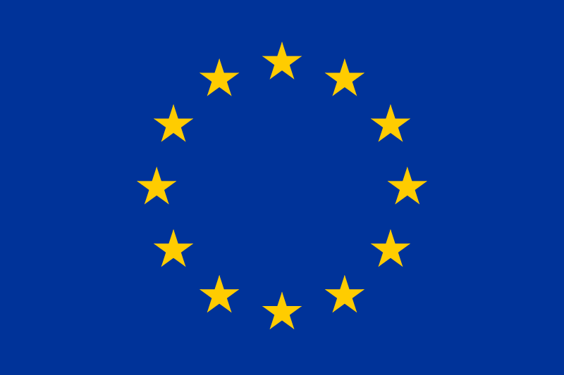
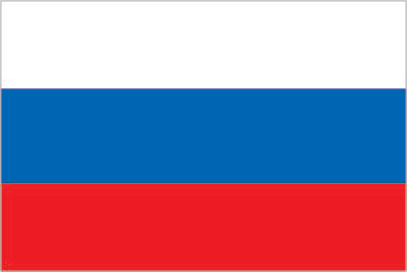
EU member state Subsumed state EU membership with opt-outs/opt-ins EEA Transitional Europe Agreement Establishing an Association Protocol 3 Association (at least four distinguishable variations) Outermost Region (OMR) Quasi-OMR EU-OCTA (OCT Association) Customs Exemptions and Monetary Agreement Non-EU-OCTA Proxy access Cooperation and Customs Union Customs Union EU exclave Deep and Comprehensive Free Trade Agreement (DCFTA) Sectorals plus Free Trade Agreement Transatlantic Trade and Investment Partnership (TTIP, pending) Comprehensive Trade and Economic Agreement (CETA, ongoing) Pre-accession Free Trade Agreement (CEFTA) Partnership Agreement within devolution FTA with amended Protocol 1 New Generation FTA Bilateral Stabilisation and Association Agreement Association Agreement and Additional Protocol Association Agreement With a Strong Trade Component Euro-Mediterranean Agreement Establishing an Association (EMAA) FTA (example ongoing) Agreement on Commercial and Economic Cooperation (ACEC) Agreement on Trade and Economic Cooperation (ATEC) Agreement on Partnership, Political Coordination and Cooperation Agreement (EPCCA) Interim Agreement on Trade and Trade-Related Matters Unacknowledged legacy access Trade Agreement Economic Partnership Agreement Interim Economic Partnership Agreement Comprehensive Partnership and Cooperation Agreement Partnership and Cooperation Agreement (PCA) Trade, Development and Cooperation Agreement (ATDC) Generalised/Global System of Preferences Plus (GSP+) Generalised/Global System of Preferences with preferential rates Partnership Agreement (several emerging variations) Cooperation Agreement Most Favoured Nation (MFN) plus Joint Programming Unofficial Currency Union sui generis subject of public international law WTO MFN Agreement on Trade and Commercial and Economic Cooperation (ATCEC) de iure membership plus Green Line legislation but with embargo Less Than WTO
www.theredcell.co.uk/research
Redrawing the ‘Barnier stairwell’ -
50 types of EU economic deal
Reviewing the EU’s historic trade treaties, even with this incomplete 2019 listing, Barnier’s little set of stairs turns out to be much more complex.
Steps are not evenly-spaced. The order itself is debatable… But the top third increasingly requires political integration.
The UK is today aiming for the optimal green area half way up - neither May’s excessively high target nor Barnier’s bottom step.
Additionally, at ‘lower steps’, any relationship further ‘climbs’ with added bilaterals and multilaterals
e.g. the US and EU are jointly party to 147 agreements

Slide 4
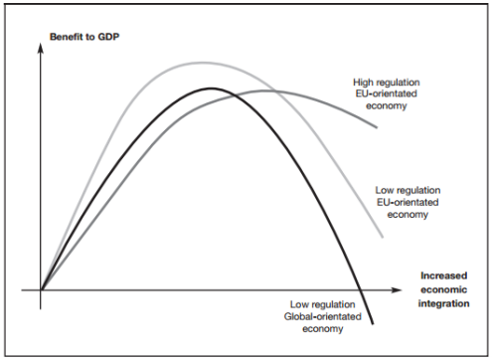
Context of relative advantage
This is important because Barnier’s ‘upper floors’ is far from where we want to be
Different countries benefit and lose in different ways by increasing political and economic integration with Brussels
The “Goldilocks Zone” - where association with the EU is neither too close nor too far but “just right” - differs from country to country
Revisiting the original Barnier slide, we can similarly suggest a colour coding of the types of EU arrangement for the UK (next slide)
“The National Interest”
www.theredcell.co.uk/research
The Freedom Curve

Slide 5
Updated modelling (OCT 20): a set of stairwells involving 65 types of deal (relative hierarchy is open to debate – the key feature is the range)
EU Membership
EU member state (Belgium)
EU member with opt-outs/opt-ins (Denmark)
Subsumed state (GDR at point of absorption)
Transitional exit status (UK over 2020).
Regulatory/ Customs Unions
EEA (Norway)
Protocol 3 Association (at least four variations, inc. Guernsey)
Outermost Region (OMR, Guadeloupe)
Quasi-OMR (Saint Barthélemy)
EU-OCTA/OCT Association (Falklands)
Customs Exemptions and Monetary Agreement (Vatican)
Non-EU-OCTA (South Georgia)
Transitional Europe Agreement Establishing an Association (Bulgaria)
Proxy access (GDR during détente)
Cooperation and Customs Union (San Marino)
Customs Union (Turkey)
EU exclaves (Büsingen am Hochrhein)
Deep and Comprehensive Free Trade Agreement (DCFTA, Ukraine)
Withdrawal Agreement with Northern Ireland Protocol (UK)
Developed Free Trade Treaties
Sectorals plus Free Trade Agreement (Switzerland)
Transatlantic Trade and Investment Partnership (TTIP, USA)
Comprehensive Trade and Economic Agreement (CETA, Canada)
Pre-accession Free Trade Agreement (CEFTA)
Partnership Agreement within devolution (Greenland)
New Generation FTA (South Korea)
FTA with amended Protocol 1 (Faroes)
Bilateral Stabilisation and Association Agreement (Macedonia)
Association Agreement and Additional Protocol (Chile)
Association Agreement With a Strong Trade Component (Central America)
Euro-Mediterranean Agreement Establishing an Association (EMAA, Israel)
Free Trade Agreement (Malaysia).
www.theredcell.co.uk/research
Trade or Development Facilitators
Framework Agreement on Commercial and Economic Cooperation (ACEC, Canada)
Trade Agreement (Colombia)
Agreement Amending ATEC (South Africa)
Agreement on Trade and Economic Cooperation (ATEC,Mongolia)
Economic Partnership Agreement (CARIFORUM)
Interim Agreement on Trade and Trade-Related Matters (Bosnia)
Interim Agreement with a View to an Economic Partnership Agreement (Central African Party)
Stepping Stone Economic Partnership Agreement (Ghana)
Interim Economic Partnership Agreement (Madagascar)
Unacknowledged legacy access (Algeria)
Trade, Development and Cooperation Agreement (asymmetric arrangement through an ATDC, South Africa)
Generalised/Global System of Preferences Plus/GSP+ (Costa Rica)
Generalised/Global System of Preferences with preferential rates (South Sudan)
Enabling Deals
Strategic Partnership Agreement (Japan)
Comprehensive Partnership and Cooperation Agreement (Vietnam)
Comprehensive and Enhanced Partnership Agreement (Armenia)
Agreement on Partnership, Political Coordination and Cooperation Agreement (EPCCA, Mexico)
Enhanced Partnership and Cooperation Agreement (Kazakhstan)
Framework Agreement on Comprehensive Partnership and Cooperation (Indonesia)
Stabilisation and Association Agreement (Albania)
Partnership and Cooperation Agreement (PCA, Russia)
Framework Agreement on Partnership and Cooperation (Mongolia)
Partnership Agreement on Relations and Cooperation (NZ)
Partnership Agreement (several emerging variations)
Framework Agreement (Australia)
Agreement of Association (UK and EESC in 1954)
Political Dialogue and Cooperation Agreement (Cuba)
Cooperation Agreement (Syria)
Most Favoured Nation plus Joint Programming (Namibia)
Baselines
Unofficial Currency Union (East Timor)
sui generis subject of public international law (Sovereign Military Order of Malta)
WTO MFN (USA)
Long Spoon Arrangements
Agreement on Trade and Commercial and Economic Cooperation (ATCEC, USSR)
de iure membership plus Green Line legislation but with an embargo (North Cyprus)
Less Than WTO (North Korea)
(PLUS: various types of sanctioned and embargoed status)
At ‘lower steps’, any relationship further ‘climbs’ in relative terms with added bilaterals and multilaterals.
The UK and EU are jointly party to 286 agreements (some to fall in 2021)

Slide 6
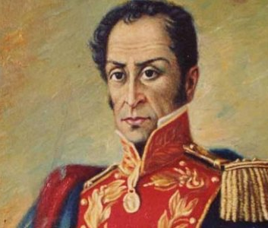
Modelling comparison: what can we learn from parallels in the Americas?
Examples with more integrationist ambitions
Alianza Bolivariana para los Pueblos de Nuestra América (ALBA); Comunidad Andina (CAN); Caribbean Community (CARICOM); Mercado Común del Sur (MERCOSUR/MERCOSUL); Organisation of Eastern Caribbean States (OECS); Sistema de la Integración Centroamericana (SICA); Unión de Naciones Suramericanas (UNASUR/UNASUL)
Examples more focused on trade and cooperation
African, Caribbean, and Pacific Group of States (ACP); Association of Caribbean States (ACS/AEC); Asociación Latinoamericana de Integración (ALADI); Asociación Latinoamericana de Libre Comercio (ALALC/LAFTA); Free Trade Area of the Americas (FTAA/ALCA); Alianza del Pacífico; Asia-Pacific Economic Cooperation (APEC); Dominican Republic-Central America FTA (CAFTA-DR); Caribbean Free Trade Association (CARIFTA); Community of Latin American and Caribbean States (CELAC); Comunidad Iberoamericana; Eastern Caribbean Common Market (ECCM); Rio Group (GRIO); Mercado Común Centroamericano (MCCA/CACM); North American Free Trade Agreement (NAFTA); Organização Tratado de Cooperação Amazônica (OCTA); Organización de Estados Centroamericanos (ODECA); Sistema Económico Latinoamericano y del Caribe (SELA); United States-Mexico-Canada Agreement (USMCA); West Indies Associated States (WISA)
Observations
Even in by far the most integrationist of regions outside of the EU, note the variety – FTAs vs Customs Unions, Cooperation agreements vs Bolivarian, microstate postcolonial mergers of scale
The majority are focused on links rather than integration
Developed economies and Common Law countries tend to pursue trade and cooperation
Protectionist and Hard Left countries prefer customs unions (anti-US undercurrent)
Microstates and small economies have the greatest inherent motive for federalising
Countries aspiring to political merger notably base their model on the EU
There is greater success at political integration where there are socio-cultural similarities and common prior historical governance. Even then, continental uniformity remains a big ask
There is always an alternative for cooperation other than chasing deep political integration, which risks wider failure when it stalls
UK Brexit negotiators should take heart and reject any Barnier Bolivarianism…
“New World Order” - www.theredcell.co.uk/research

